Slide 1
Tableau

Slide 2
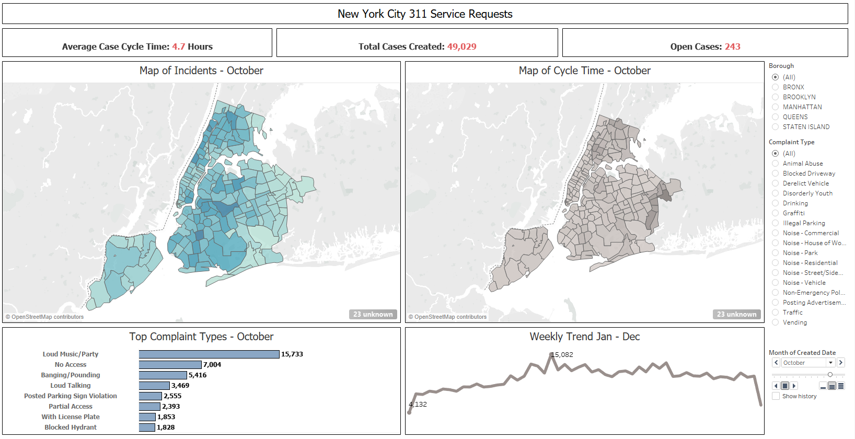
New York City 311 Service Requests

Slide 3
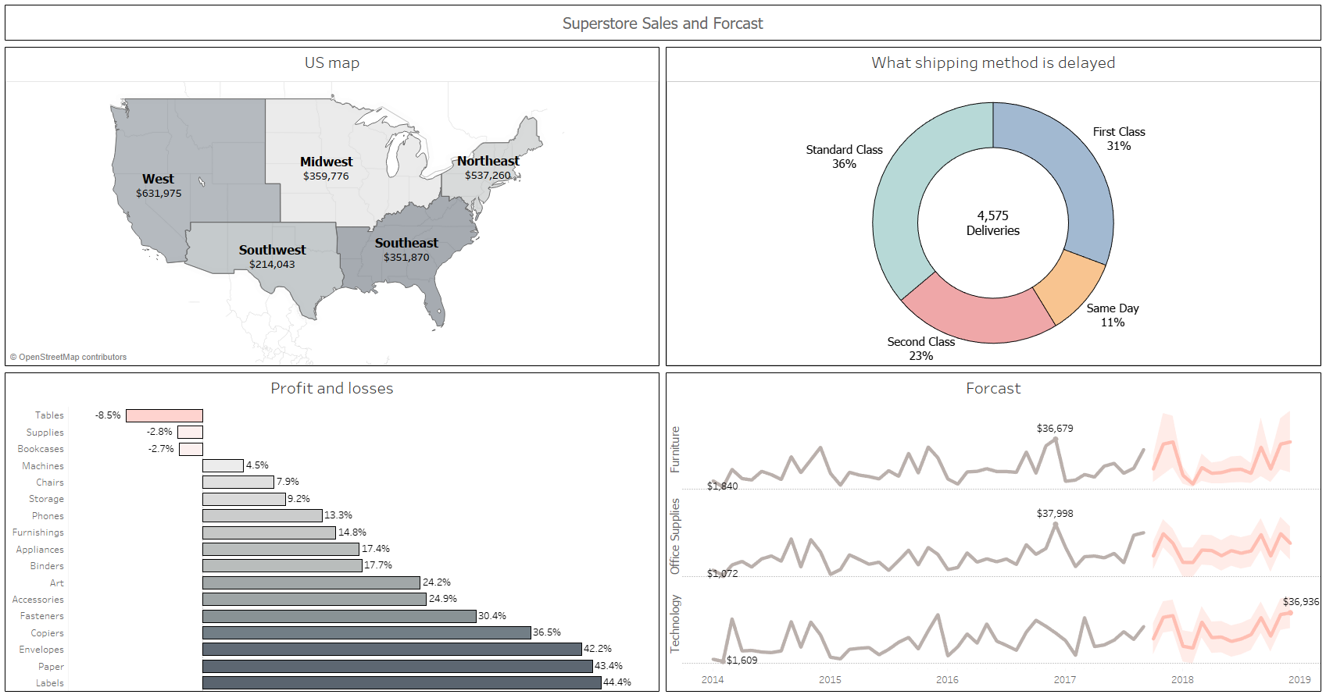
Superstore Sales and Forcast

